Slide 1

DESIGN THINKING AND INNOVATION LAB
TEAM – SENTINEL
By-
REDDY JAHNAVI – 324103310200
SHAIK SAZIDA – 324103310214
YEDLA JOSHIKA – 324103310260

Slide 2

SAFE ROUTE:
An AI-Based Intelligent Travel Guardian for Women Safety

Slide 3
EMPATHIZE – Identifying the Problem
Understanding Users (Women Travelers):Women face safety risks during travel, especially at night or in isolated areas.
In emergency situations, manual actions (like pressing SOS) may not be possible.
Users often feel unsafe but cannot continuously inform others.
Current apps only help after danger occurs, not before fear and panic can prevent users from reacting quickly.
Need for automatic, real-time protection without user effort

Slide 4
2. DEFINE – Introduction to the Problem
Problem Statement:
Existing women safety apps:
Require manual activation (panic button)Only share location, not analyze safety
Do not consider: Route safetyTime (night/day risk)User movement patterns
Core Problem: There is no system that provides continuous, intelligent, and automatic safety monitoring during travel.

Slide 5
IDEATE – Creative Solutions
Proposed Idea: SafeRoute
An AI-based intelligent travel safety appWorks automatically in the background
Uses:
AI voice interaction
Route + time-based risk analysis
Movement detection
Idea is to create a “virtual guardian”that:
Monitors user continuously
Detects danger situations
Responds without user input

Slide 6
FEATURES OF APP:
Automatic Guard Mode → Starts automatically when the user confirms they are travelling and runs in the background without needing to open the app.
Route-Based Risk Detection → Analyzes whether the user is on a crowded main road or an isolated path and adjusts safety checks accordingly.
Time-Based Risk Monitoring → Increases alertness during late night or early morning hours
when risk is generally higher.
Movement Pattern Analysis → Detects whether the user is walking,
in a vehicle, or has stopped unusually in a risky area.
Multilingual Voice AI Interaction → Periodically asks the
user “Are you safe?” and understands responses in multiple languages.

Slide 7
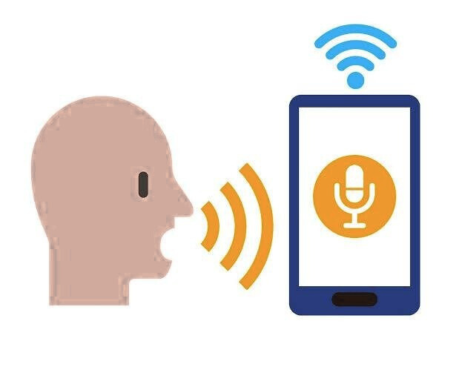
3-Step Safety Verification → Performs repeated checks before
triggering alerts to reduce false alarms.
Automatic Emergency Alert → Sends live location and alerts to emergency contacts and nearby police if the user fails to respond.
Works in Background (Foreground Service) → Continues monitoring without interrupting other phone activities.
Offline Safety Mode → Uses GPS, sensors, and SMS
alerts even when internet is not available.
Dynamic Safety Map Creation → Builds route safety
intelligence automatically using news data and user
movement patterns.

Slide 8
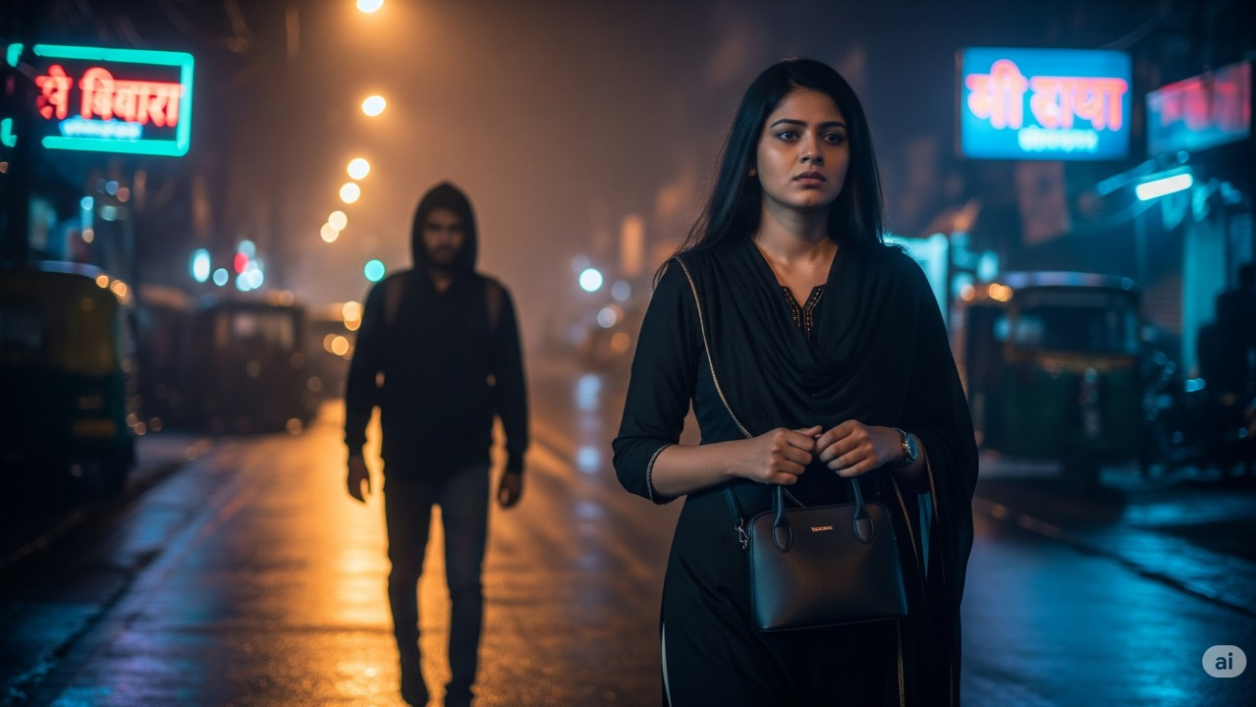
WORKFLOW
Travel Detection
(User confirms travelling)
Route & Context Analysis
(Route,Time,Crowd Density)
App setup & permissions
(Location,Mic,SMS,Bg)
Continuous Background
Monitoring (GPS & Movement)

Slide 9
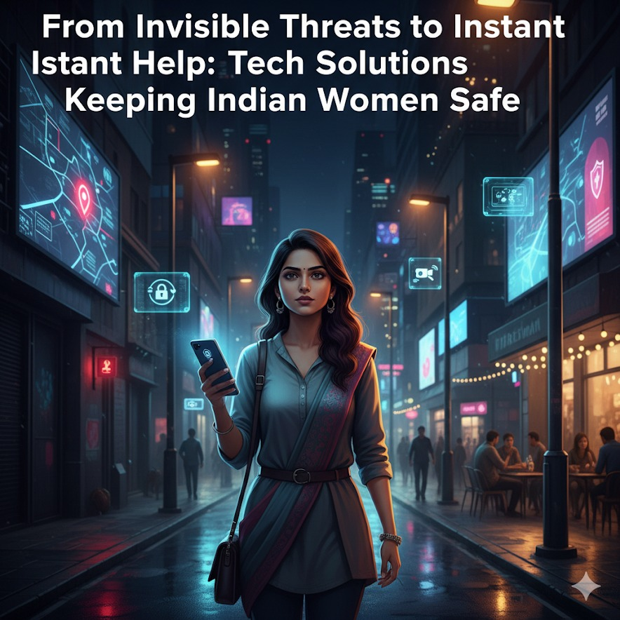
Voice AI Interaction
(“Are you safe”)
Emergency alerts & offline handling
Journey completion & safety map update
3-step Safety Verification
(Voice -> Movement-> Context)

Slide 10
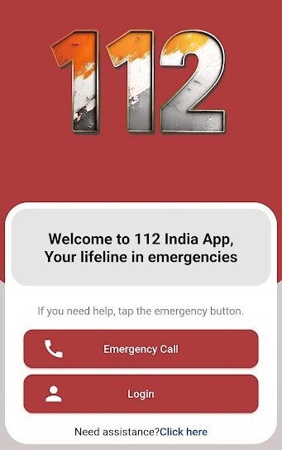
SURVEY
112 India / 112 SOS
Unified emergency number app supported by the Government of India.
Provides quick access to police, fire, and medical services.
Allows SOS alerts with location.
Basic panic button and emergency call service.
Limitation: Requires manual activation; no continuous monitoring.

Slide 11
📱 bSafe
What it does:
✔ SOS panic button sends distress alerts with real-time location to contacts.
✔ Optional live video/audio recording.
✔ “Follow Me” live GPS trace.
Limitations:
❌ Requires manual panic activation.
❌ No proactive risk analysis.
❌ No continuous guarding or voice interaction.
📱 My Safetipin / WanderSafe / MySIS (Route/area safety apps)
What they do:
✔ Provide safety scores of areas/routes based on crowd, lighting, environment.
✔ Helps choose safer routes.
Limitations:
❌ Not an automatic travel guardian.
❌ Not voice interactive.
❌ Does not guard user during travel in real time.

Slide 12
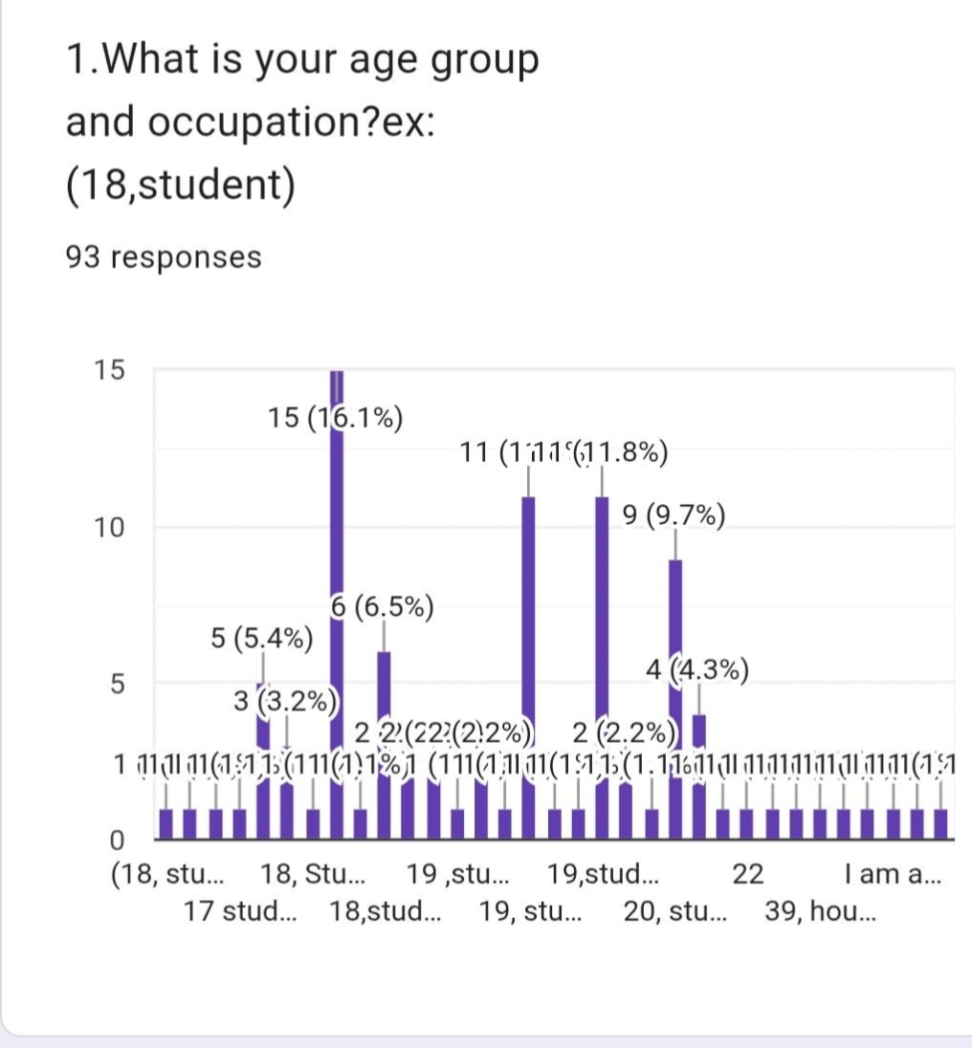
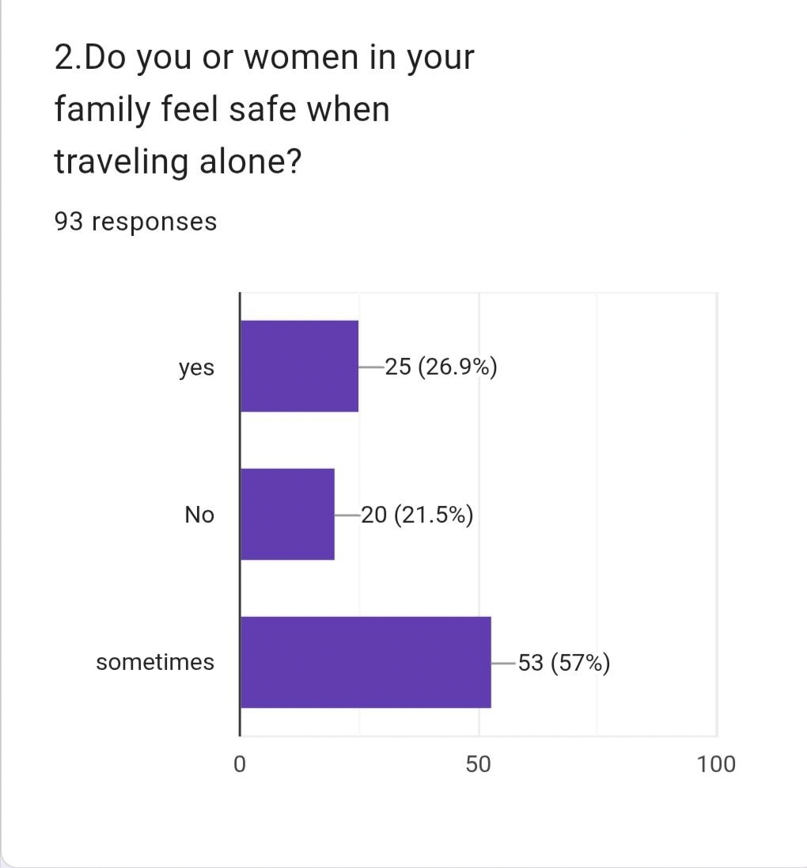
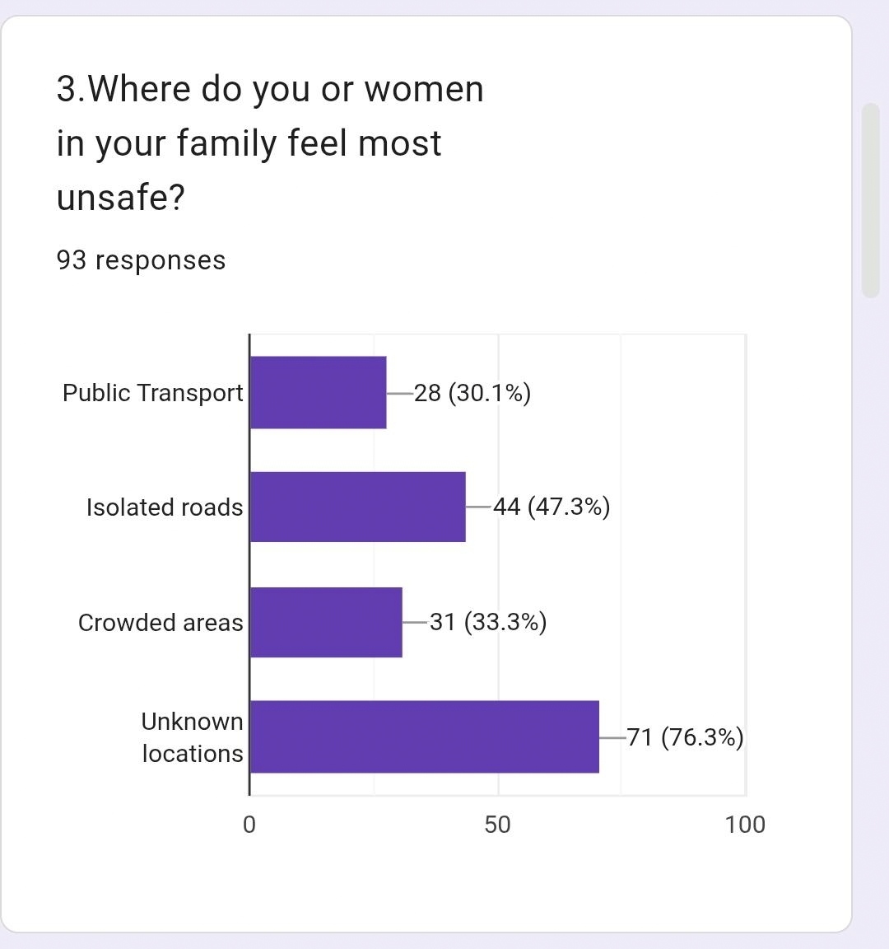
SURVEY REPORT:

Slide 13
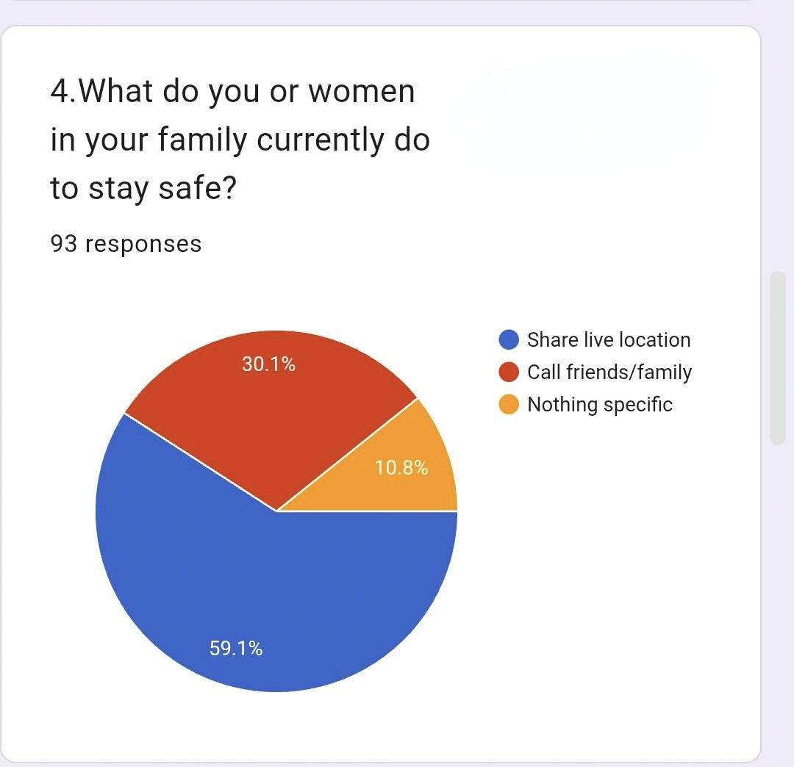
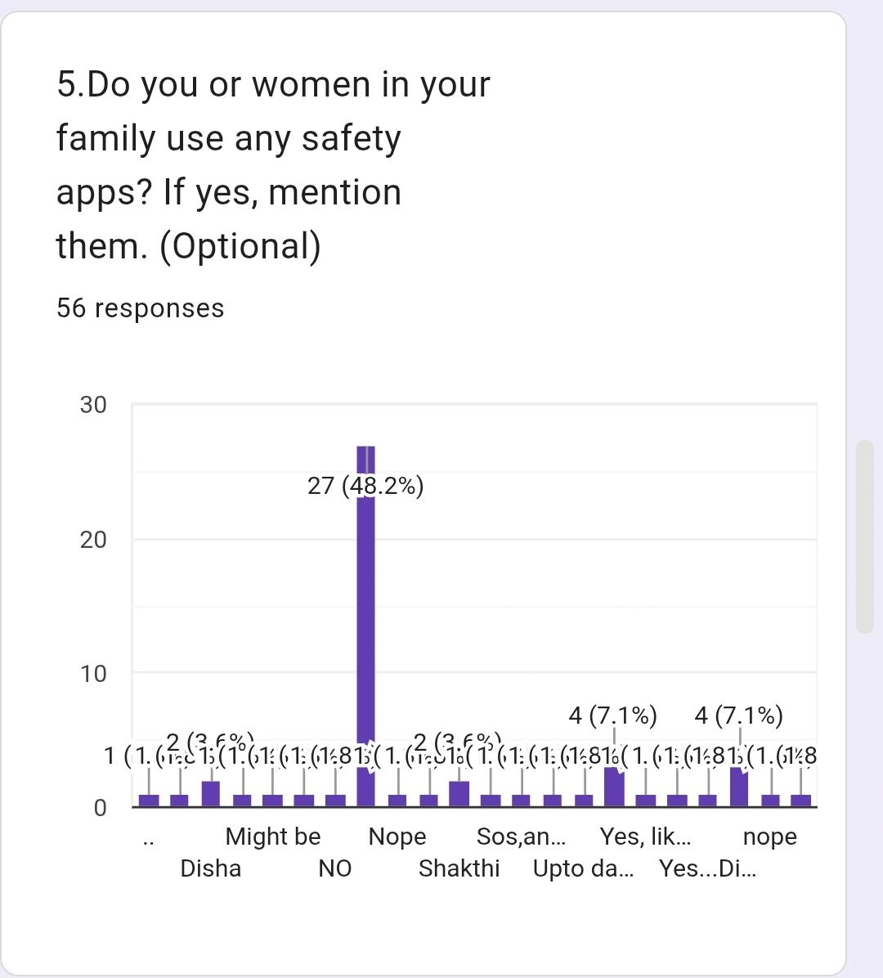
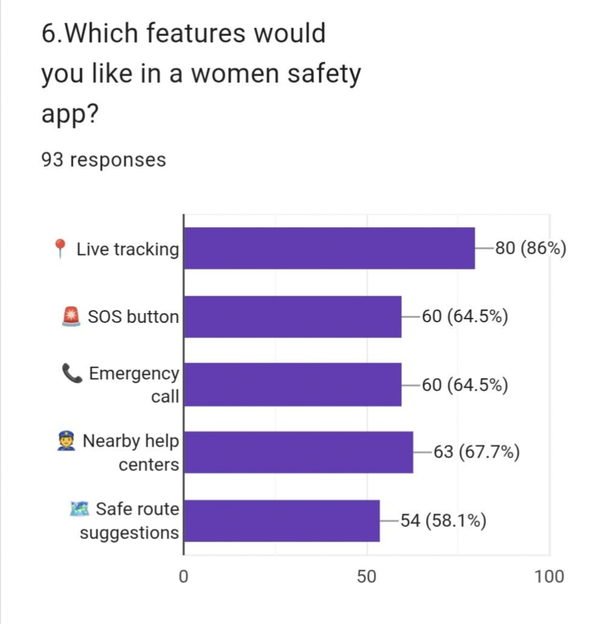
SURVEY REPORT:

Slide 14
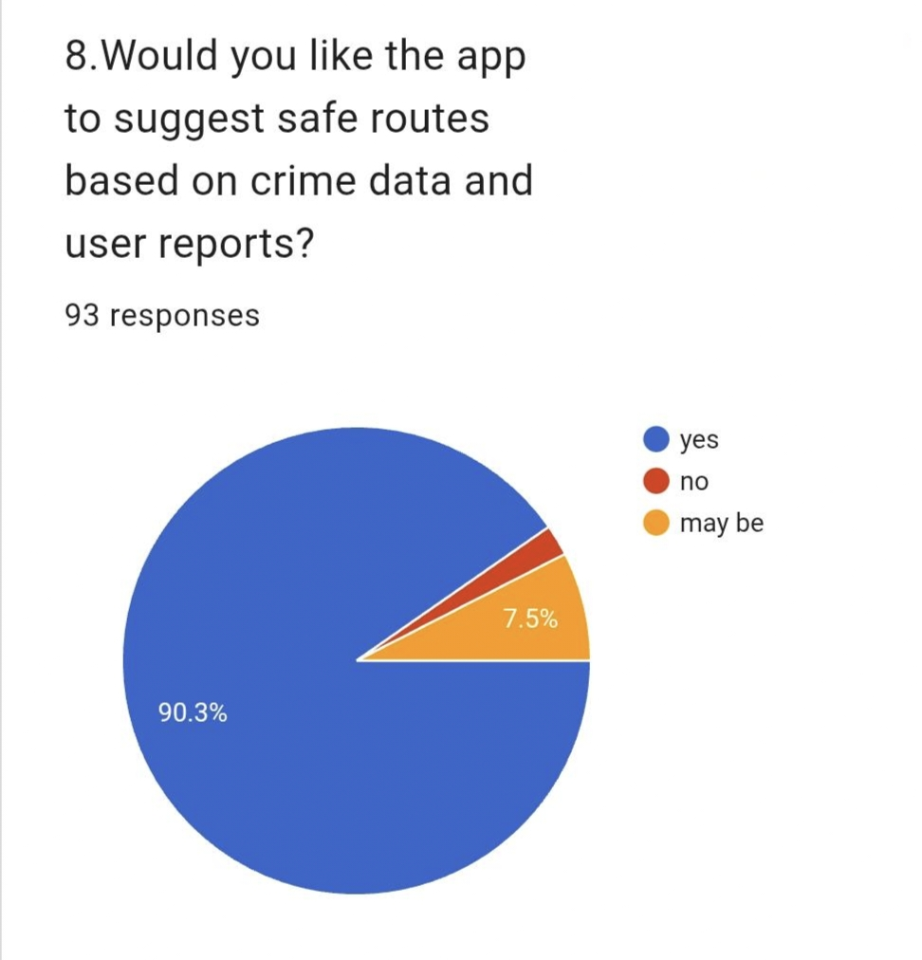
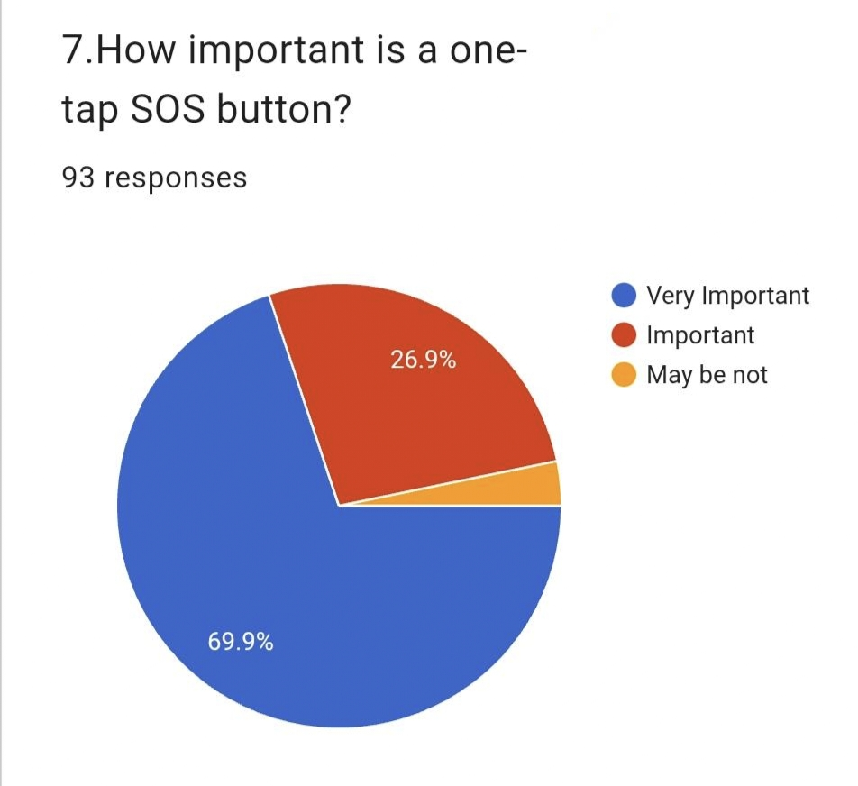
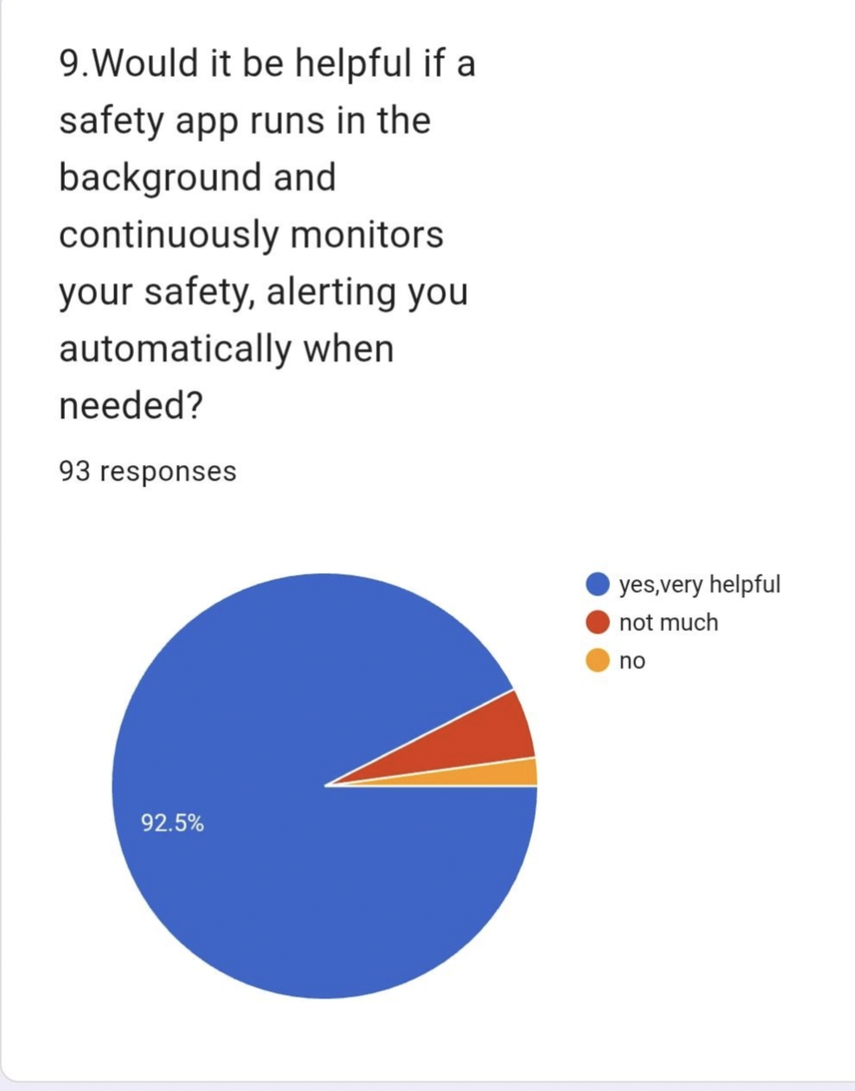
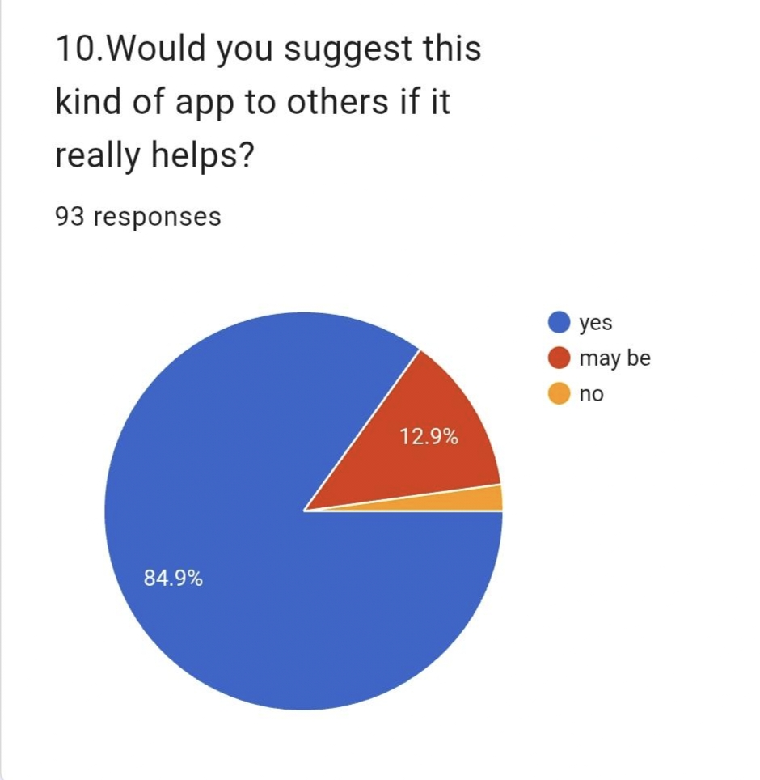
SURVEY REPORT:

Slide 15
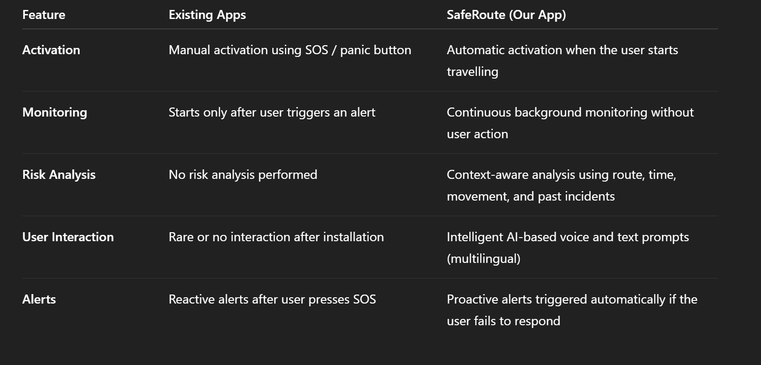
Why safe route is better?

Slide 16
TECHNICAL SKILLS TO
BE USED
Python Programming - Main development language - Handles logic, data processing, and system control
Data Handling & Analysis - To manage datasets (crime, routes, time data) , To compute safety scores automatically
Artificial Intelligence / ML Concepts - To convert raw data → intelligent decisions ,To classify routes as safe / risky
Natural Language Processing (NLP) - Detect words like: “attack, harassment, robbery”
Real-Time Monitoring System - Timer-based safety checks, Non-response detection
Cyber Security Concepts – Authentication, Data protection, Secure communication

Slide 17
CONCLUSION
By leveraging AI and available data sources, we can develop innovative solutions like SafeRoute that go beyond existing apps, providing proactive, intelligent safety for users. While some problems cannot be completely solved, AI enables prediction, real-time monitoring, and timely assistance, helping users effectively when risk arises. Despite a few limitations, our motivation was to take a step forward in creating a safer, faster, and smarter version of women safety apps, demonstrating how technology can improve protection and make travel safer for everyone.

Slide 18
THANK YOU

